Slide 1
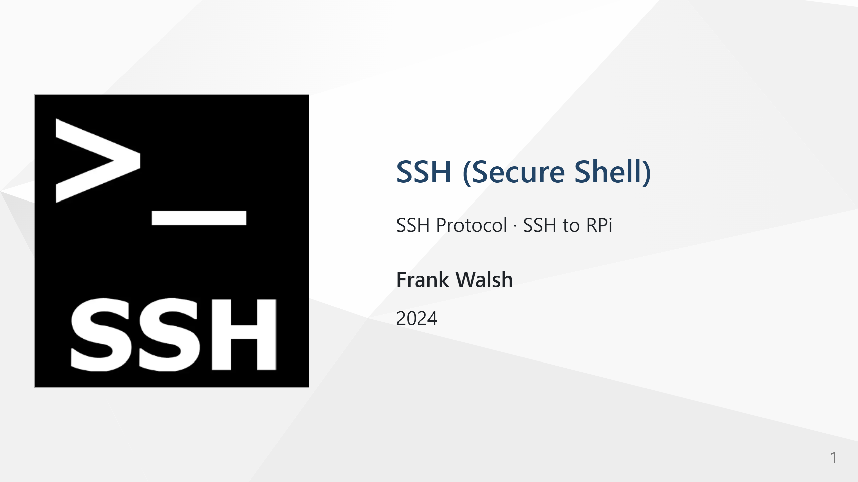

Slide 2
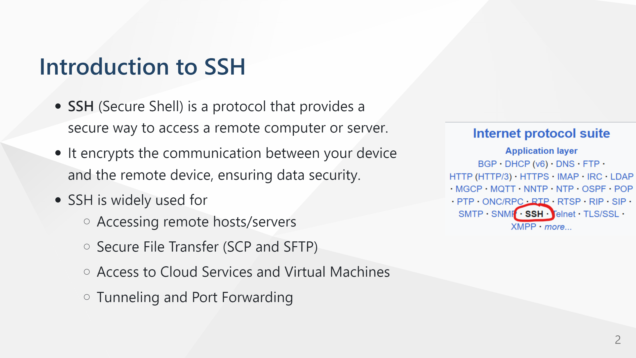

Slide 3
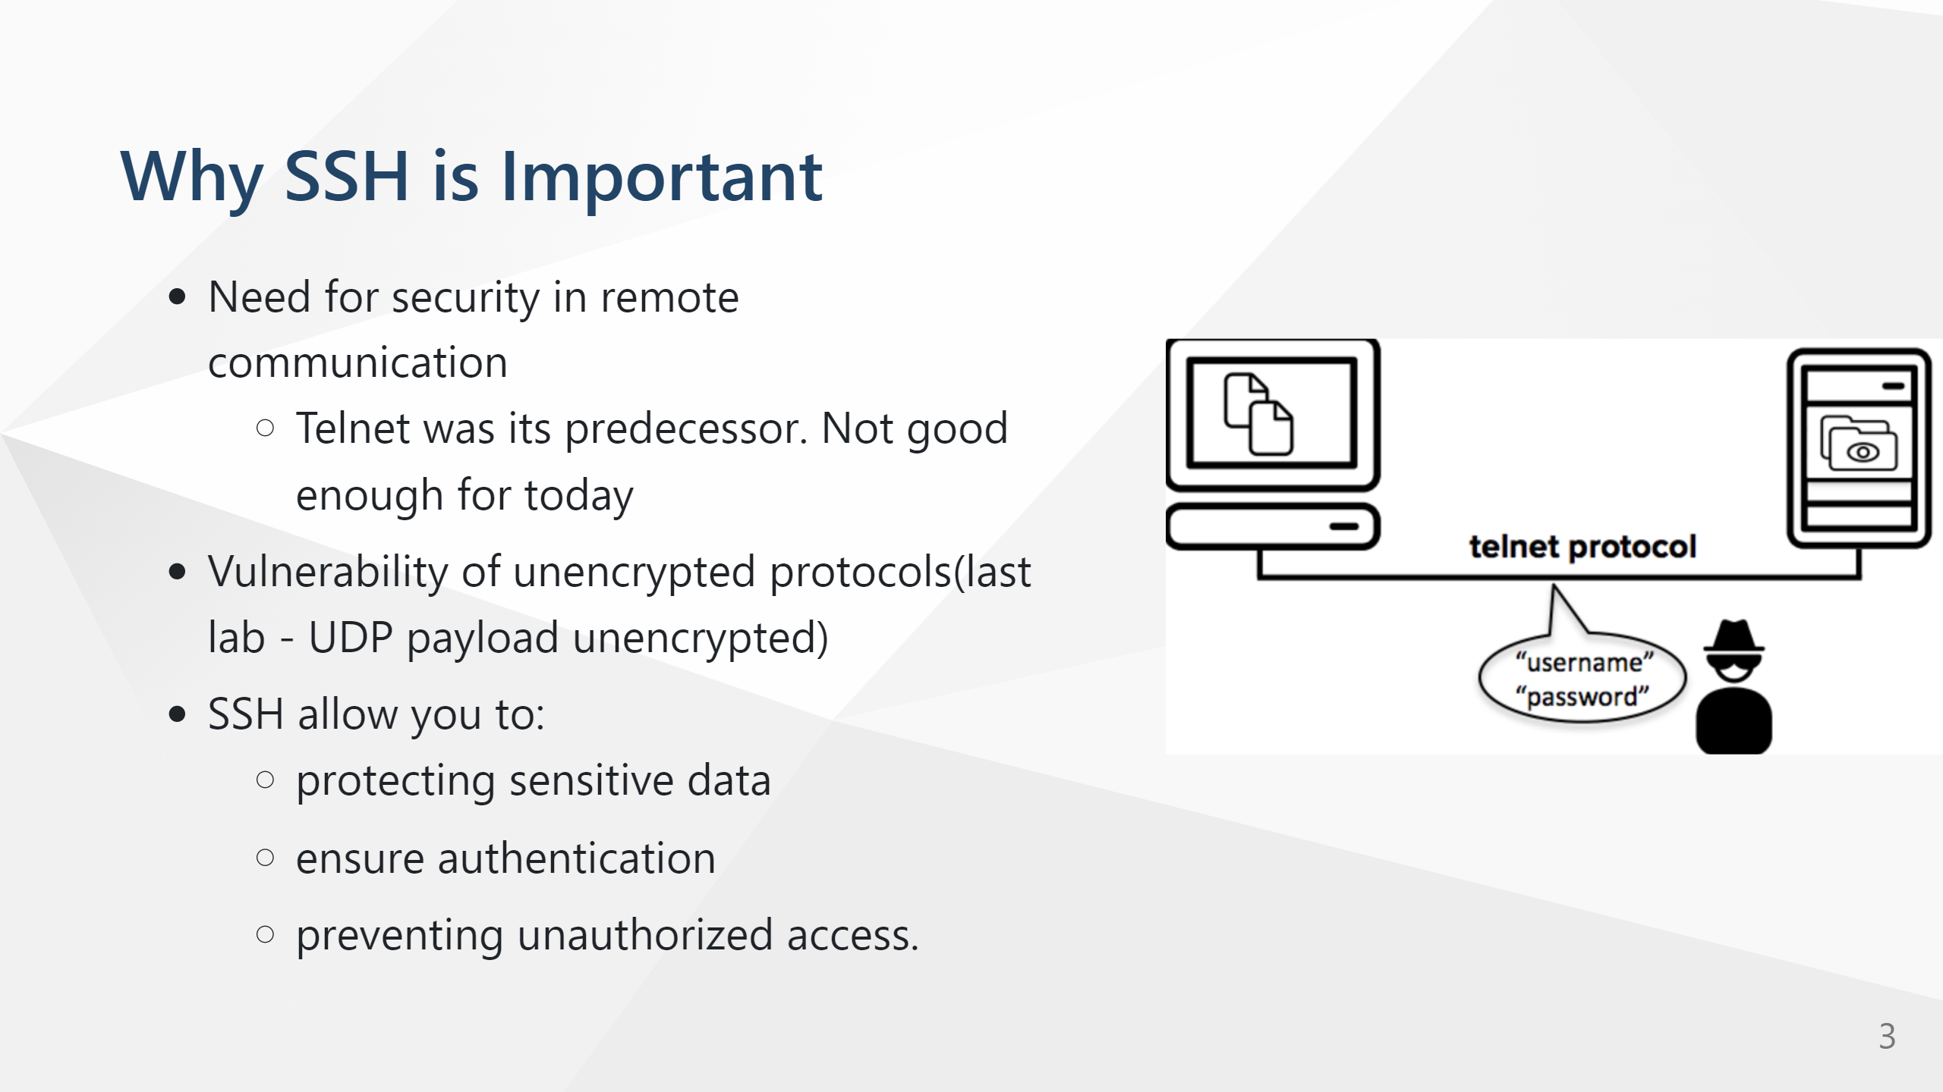

Slide 4
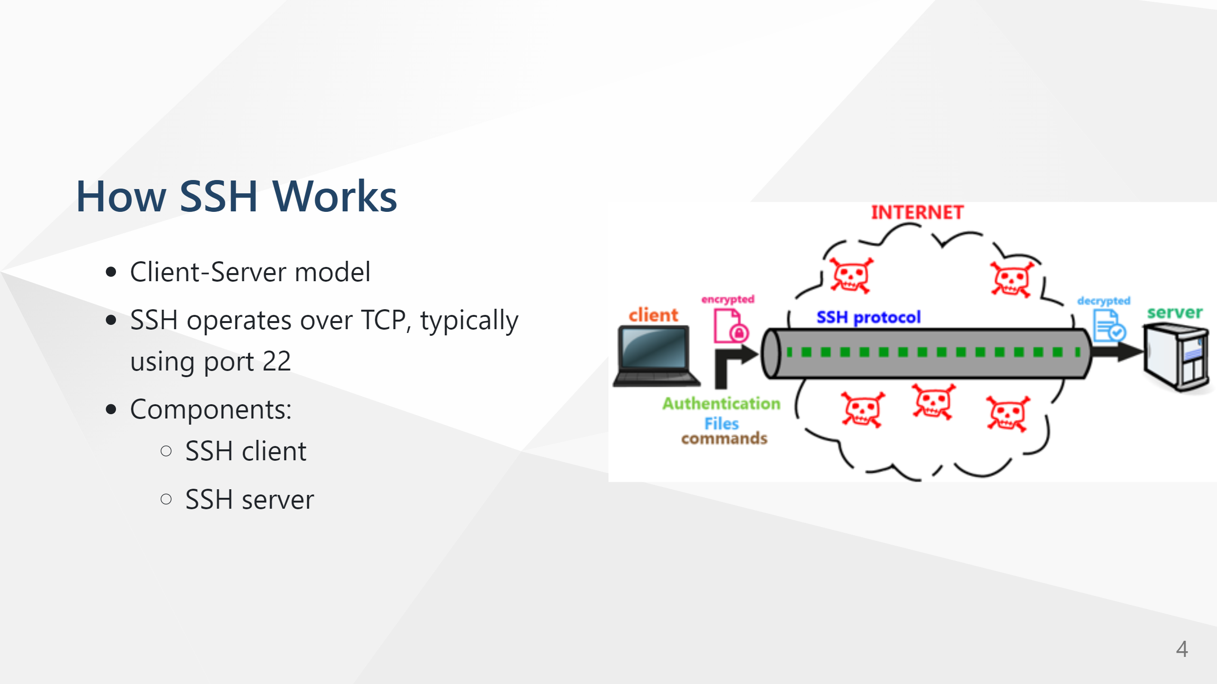

Slide 5
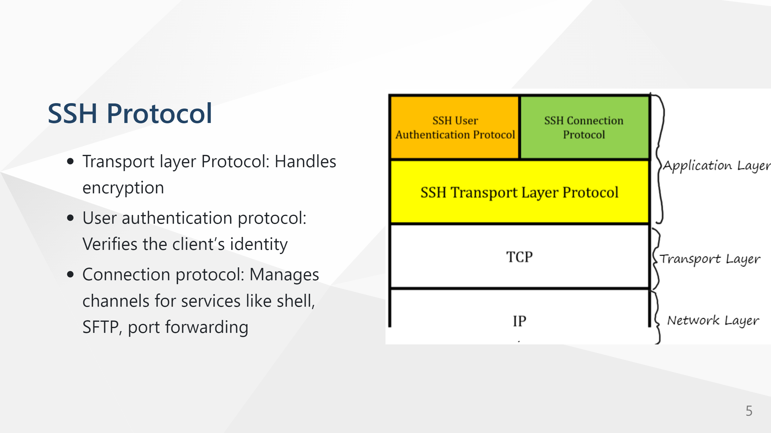

Slide 6
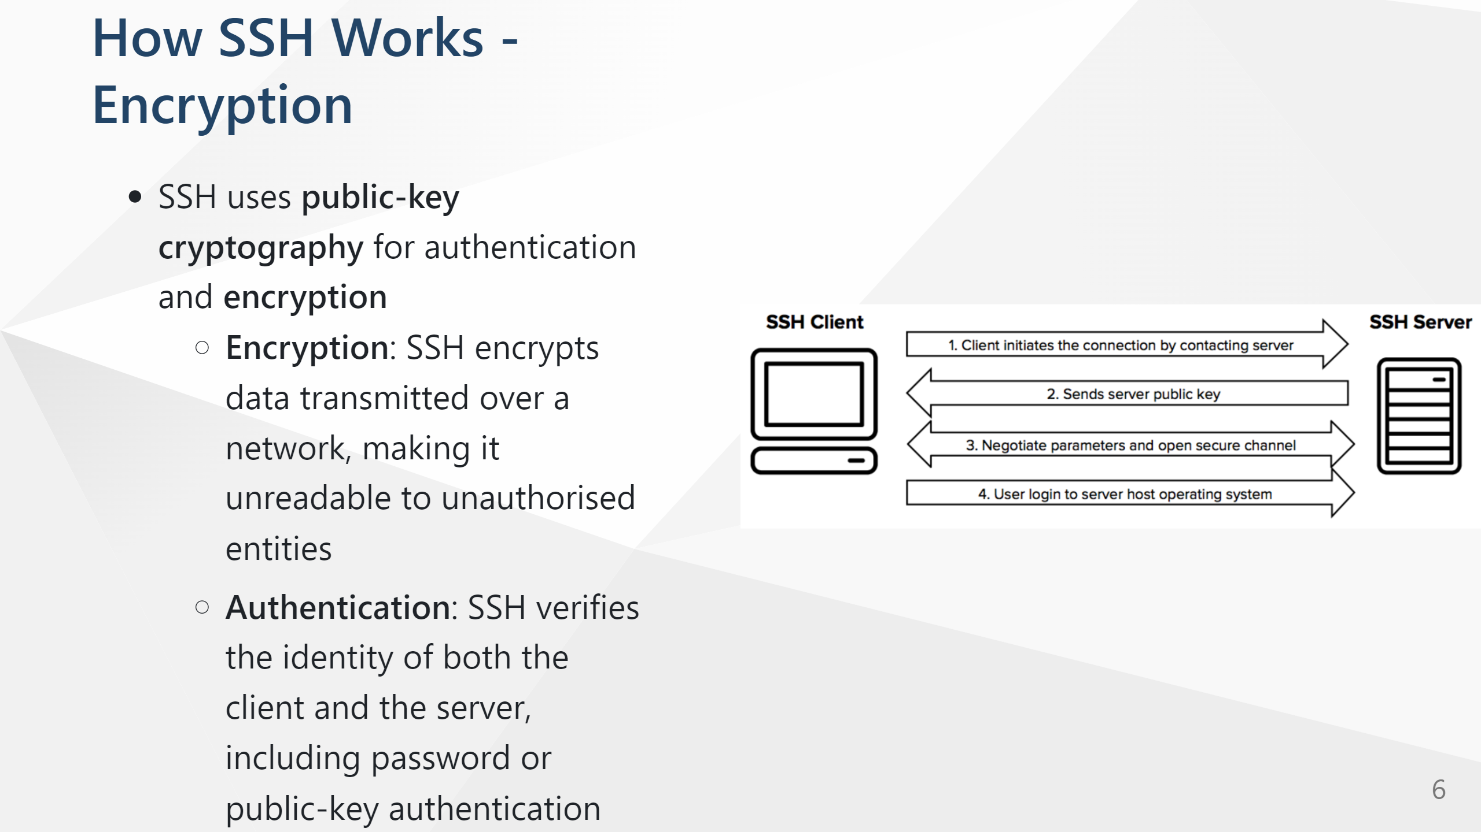
Notes:
In SSH, the server sends its public key to the client during the key exchange process, which occurs right after the connection is initiated and before any sensitive data (such as authentication credentials) is transmitted. Here’s how and why this happens:
Initial Connection and Key Exchange:
When the SSH client connects to the server, they agree on the key exchange algorithm to use, like Diffie-Hellman.
As part of this process, the server sends its public host key to the client. This key is unique to the server and acts as an identifier to help the client verify that it is connecting to the legitimate server.
Host Key Verification:
When the client receives the server’s public host key, it checks this key against a known hosts list (usually stored in the client’s ~/.ssh/known_hosts file).
If the key matches an entry in this file, the client assumes it’s connecting to the legitimate server. If not, the client may issue a warning, and the user can choose to proceed or cancel the connection.
This verification helps protect against man-in-the-middle attacks by ensuring that the client is not connecting to a malicious server impersonating the legitimate one.
Symmetric Key Generation:
After the server’s public key is verified, the client and server use the agreed-upon key exchange algorithm to generate a shared secret based on each other’s public information. This shared secret will be used to create symmetric encryption keys for the session.

Slide 7
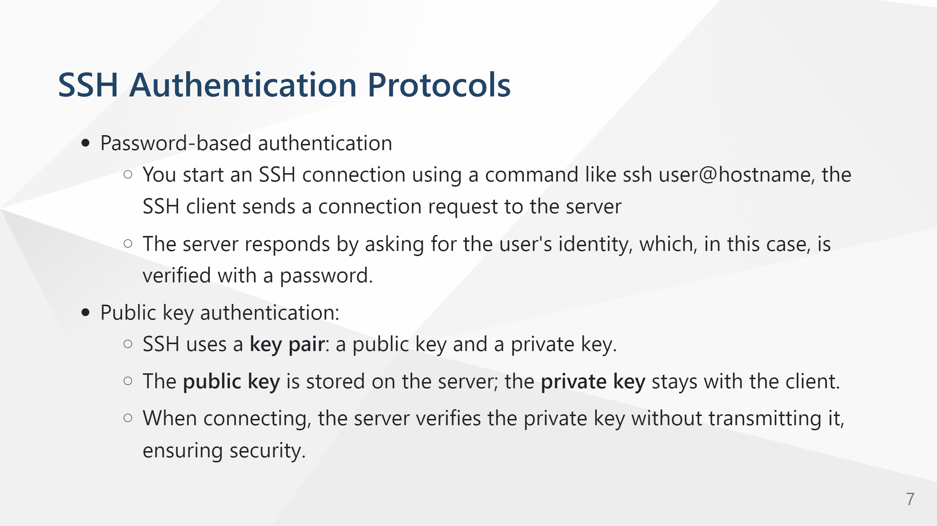

Slide 8


Slide 9
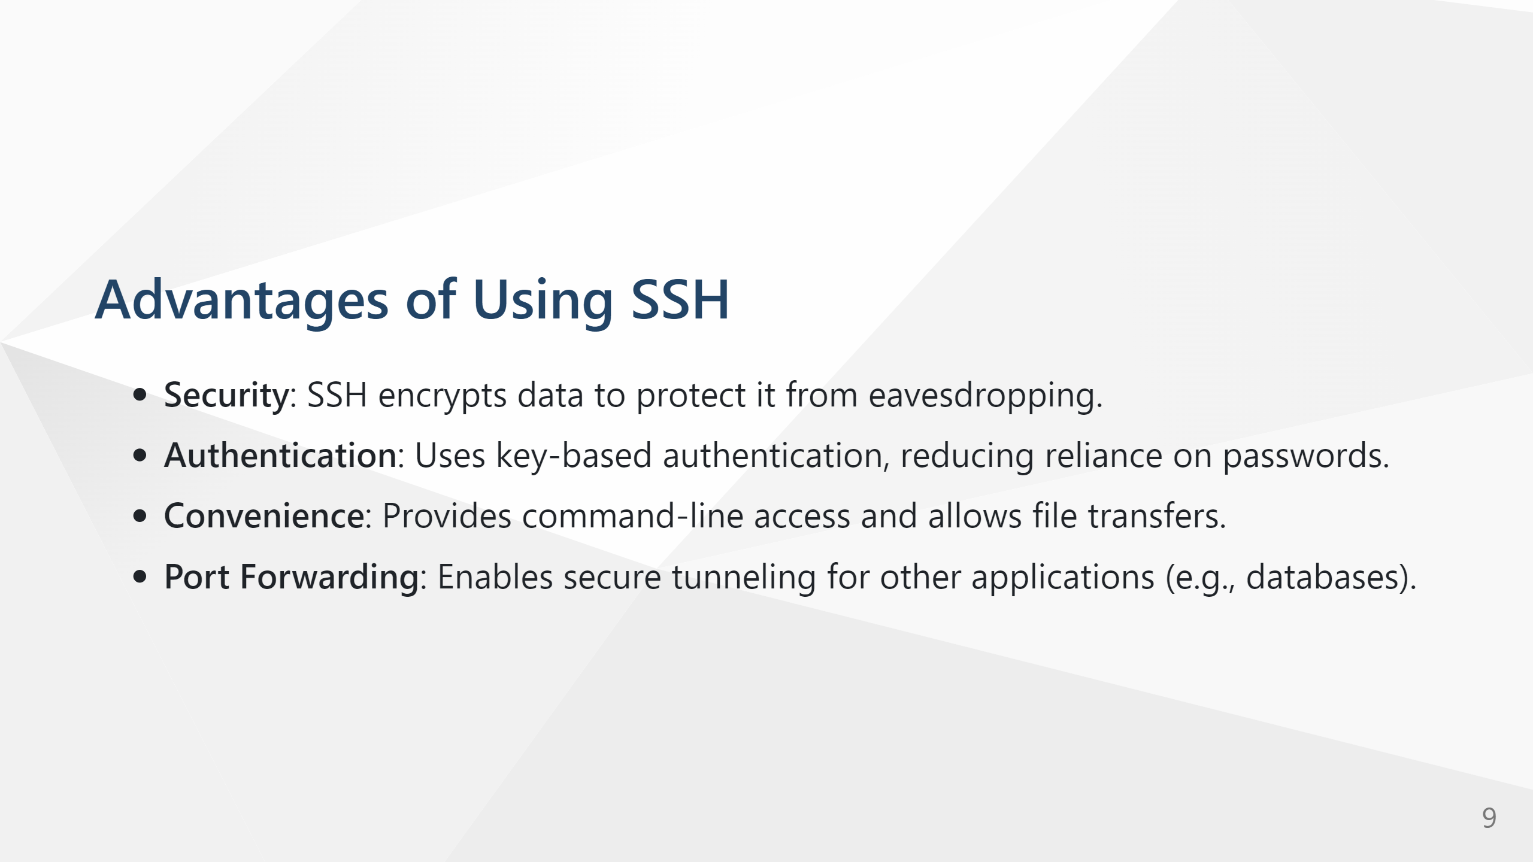

Slide 10
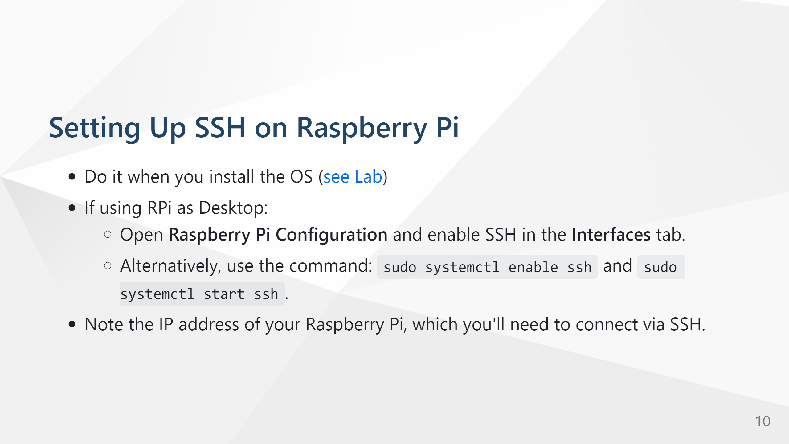

Slide 11
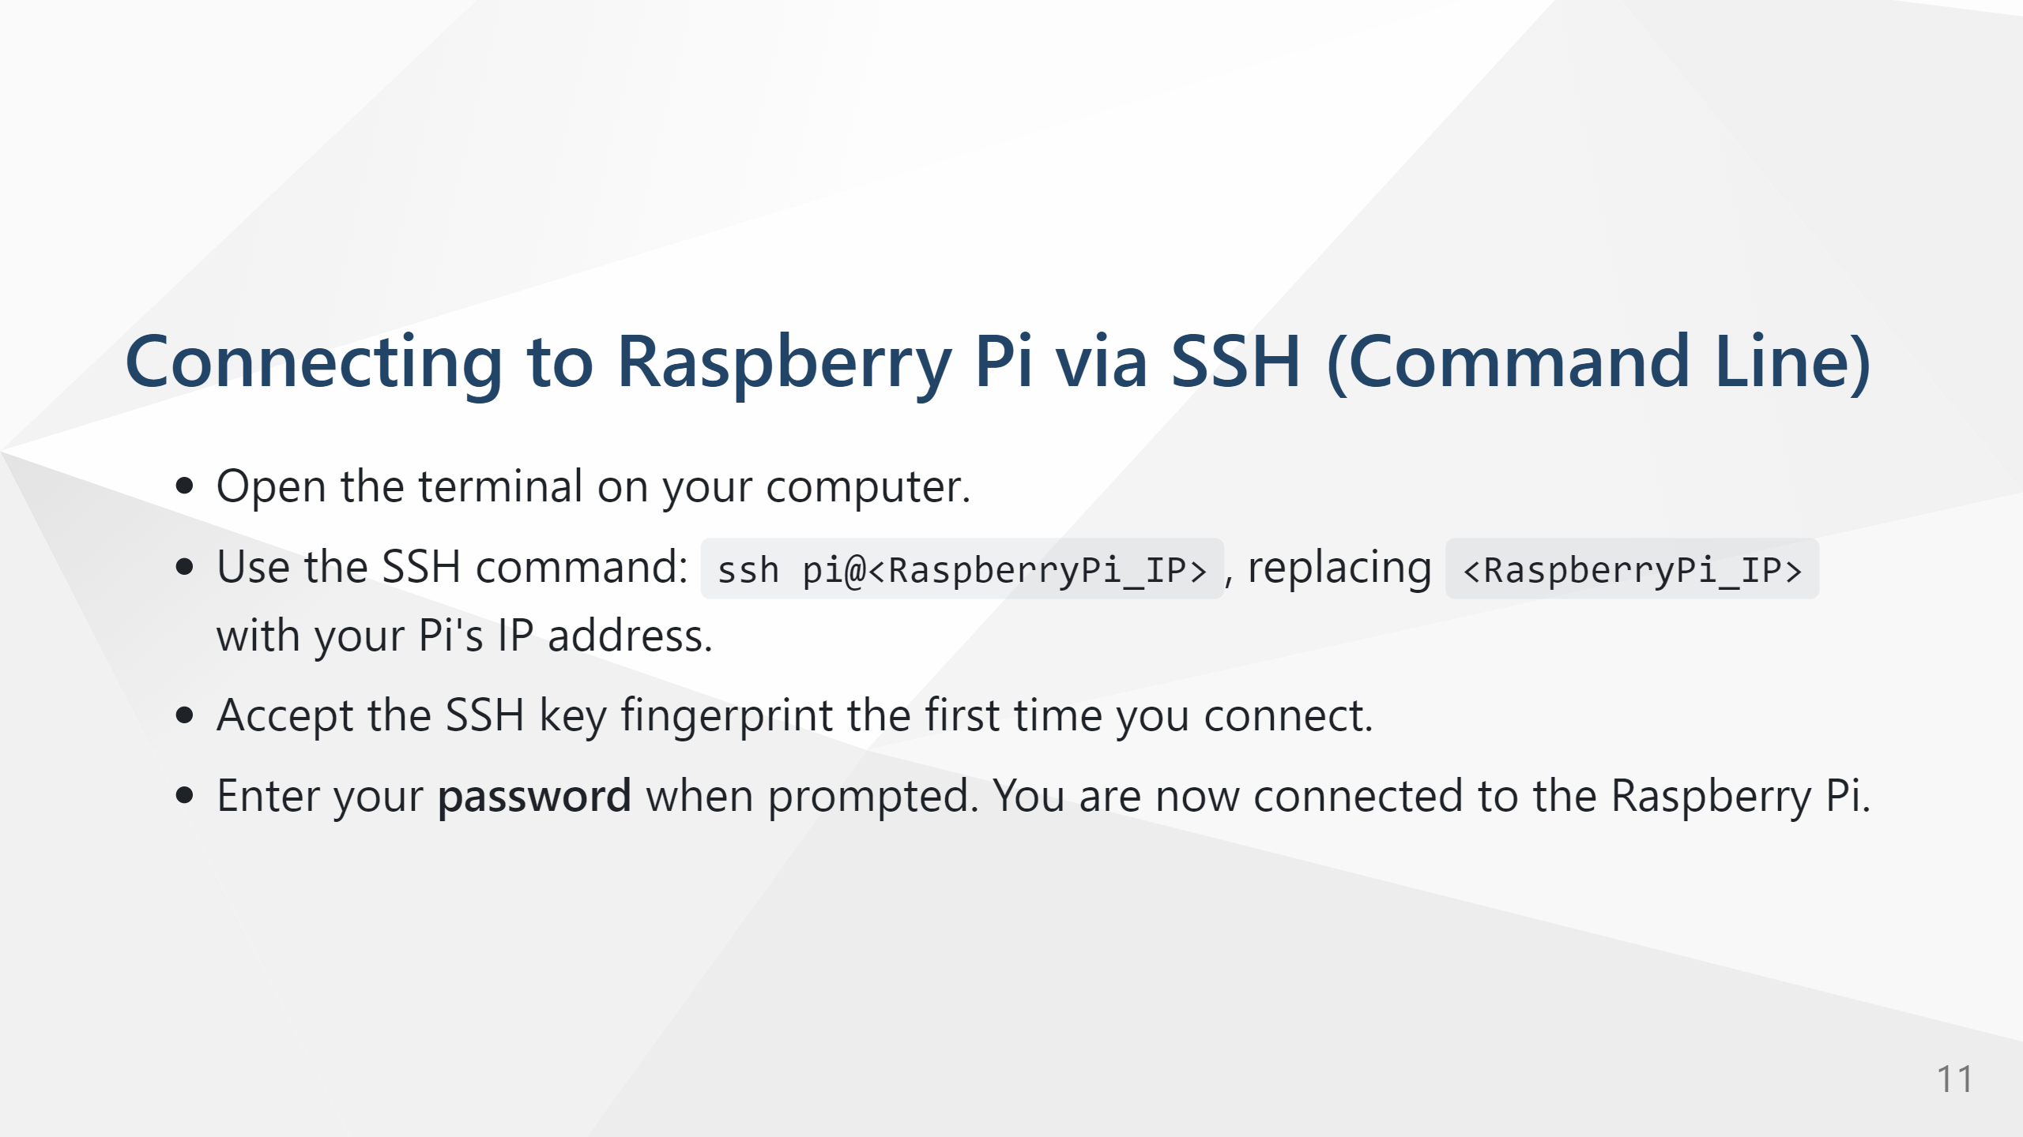

Slide 12
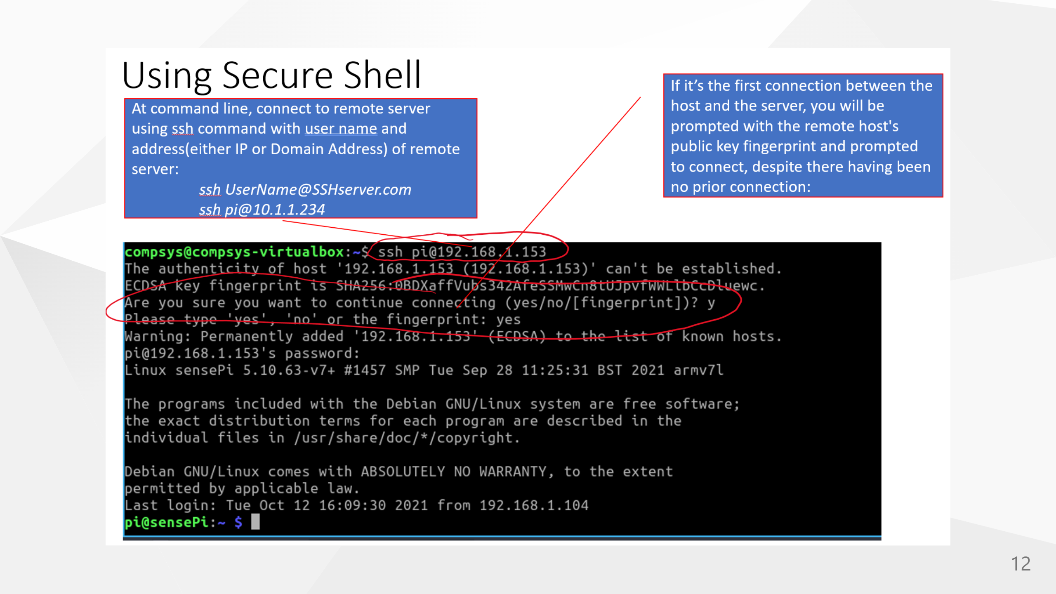

Slide 13
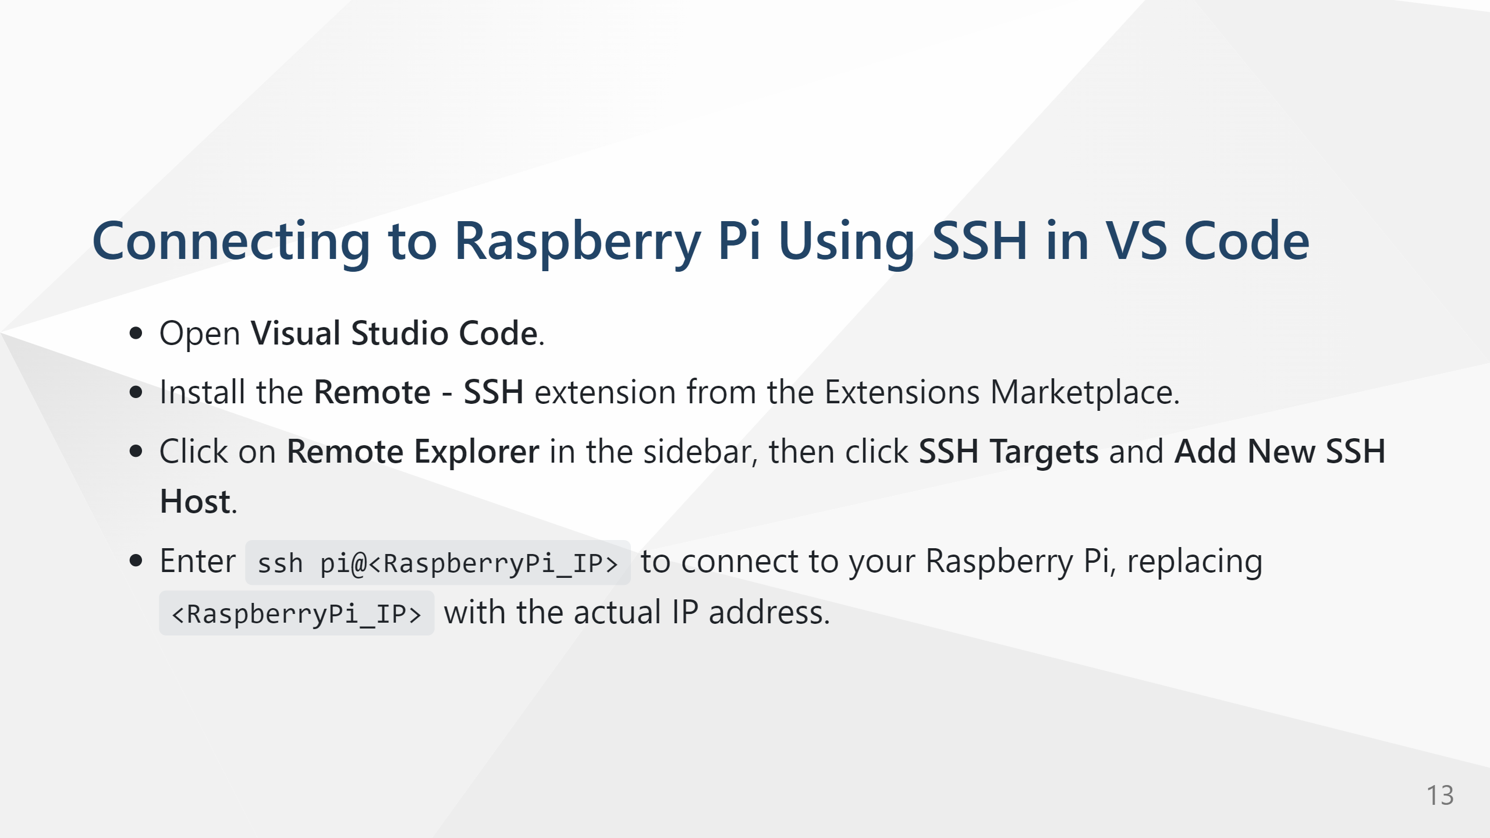

Slide 14
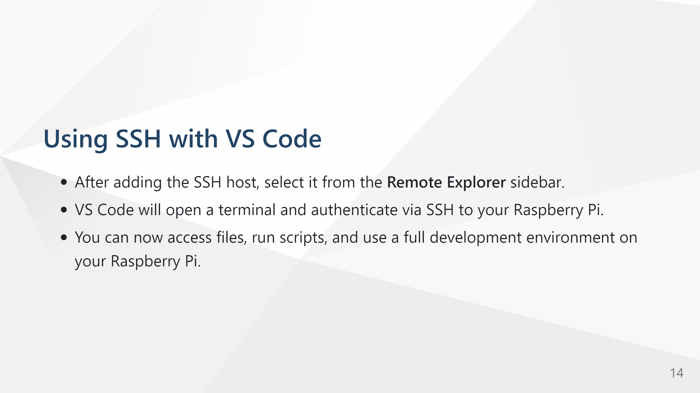

Slide 15
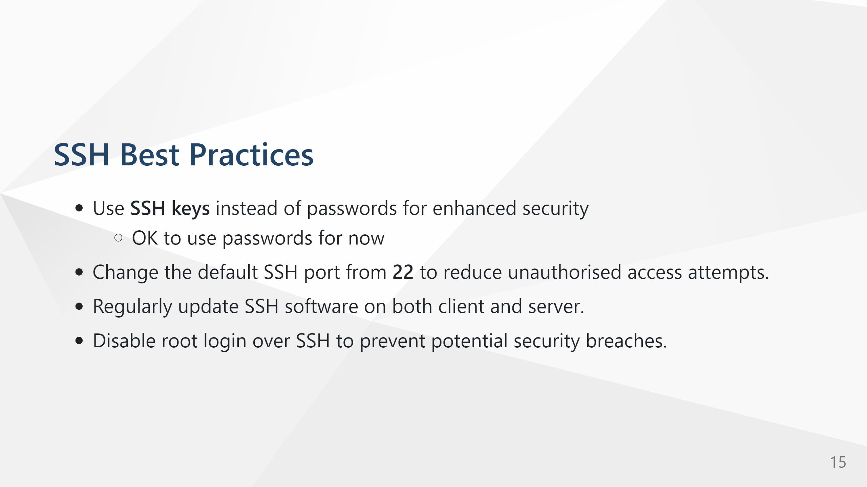

Slide 16


